Slide 1







Stack Overflow’s Annual Developer Survey 2019 Findings & Implications
Isolda Veruska de Almirante Silva
11/11/2022

Slide 2



OUTLINE
Executive Summary
Introduction
Methodology
Results
Visualization – Charts
Dashboard
Discussion
Findings & Implications
Conclusion
Appendix

Slide 3

EXECUTIVE SUMMARY
Current Technology Usage
Top 10 Languages Worked With
Top 10 Databases Worked With
Most Used Platforms
Top 10 Web Frames Worked With
Future Technology Trends
Top 10 Languages Desired Next Year
Top 10 Databases Desired Next Year
Platform Desired Next Year
Top 10 Web Frames Desired Next Year
Demographics
Respondents by Gender
Respondents by Country
Respondents Count by Age
Respondent Count by Gender, classified by Formal Education Level

Slide 4

INTRODUCTION
Data collected from Stack Overflow Developer Survey 2019 and provided by IBM.
Purpose of the Analysis
Identify the most popular programming languages, databases, platforms and web frames
Identify the skills needed for the future
Demographics
These findings are especially relevant for:
Workers and leaders in the IT and Data Science fields
Recruiters

Slide 5

METHODOLOGY
Data Source:
Stack Overflow’s Annual Developer Survey 2019 (https://insights.stackoverflow.com/survey/).
Sample:
Around 90,000 developers took the 20-minute survey in early 2019
Purpose of the Survey:
Collect data on technology usage and key trends among developers
Data Wrangling:
Dataset (https://cf-courses-data.s3.us.cloud-object-storage.a: ppdomain.cloud/IBM-DA0321EN-SkillsNetwork/LargeData/m1_survey_data.csv) provided by IBM was loaded and cleaned using SQL and Python’s pandas library.
Analysis and Visualization:
Cognos and Python libraries

Slide 6
RESULTS

Slide 7
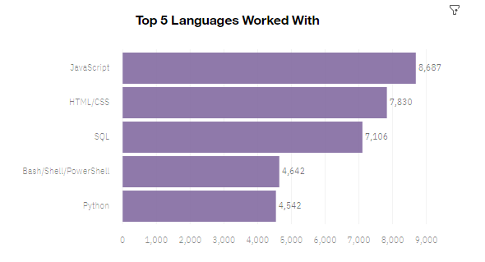
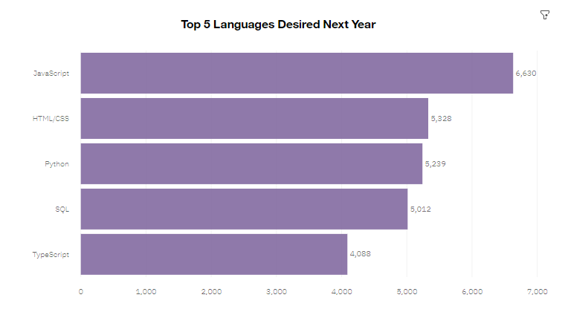
PROGRAMMING LANGUAGE TRENDS
Current Year
Next Year

Slide 8
PROGRAMMING LANGUAGE TRENDS - FINDINGS & IMPLICATIONS
Findings
The most popular language is JavaScript, followed by HTML/CSS and SQL, respectively
The popularity of JavaScript and HTML/CSS holds for the next year, but SQL loses a spot to Python
TypeScript appears in the top 5 of most wanted languages ​​for the next year
Implications
Java and HTML are languages ​​widely used by developers, while SQL is more widely used by data analysts
Despite Python's growing popularity in the data space, SQL continues to be widely used and in demand
TypeScript has been gaining popularity and demanding greater mastery from developers

Slide 9
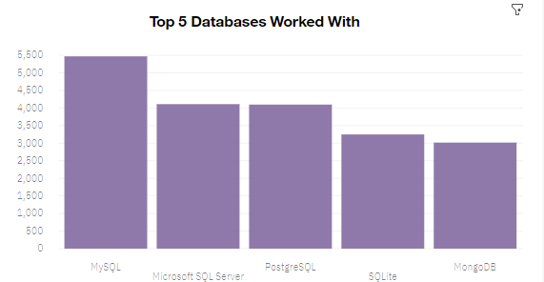
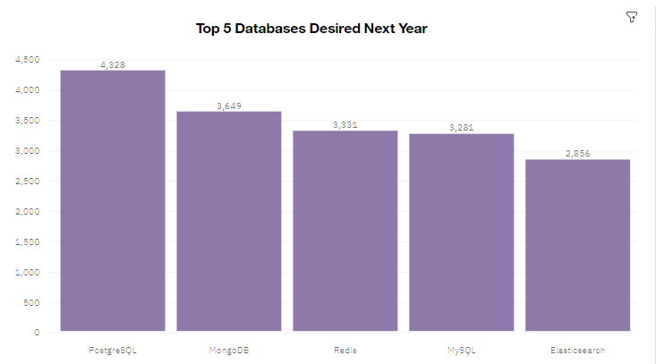
DATABASE TRENDS
Current Year
Next Year

Slide 10
DATABASE TRENDS - FINDINGS & IMPLICATIONS
Findings
MySQL is the top database of the present year of the survey
There has been a significant increase in preference for MongoDB
PostgreSQL is gaining popularity over other SQL database programs for the next year
Implications
Open-source databases have proved popular with developers
NoSQL databases have been gaining more space among developers and in the data space

Slide 11

DASHBOARD
The link below contains the complete and interactive Cognos dashboards:
https://dataplatform.cloud.ibm.com/dashboards/21f5a169-52c6-4dd0-a033-3b33083b529c/view/7924fd246280379174f7f6e4079b7a077d642d55e4bb8a51d5817b495c337997a96f1a98c87a1e09d3405736a5bf135d9d.

Slide 12
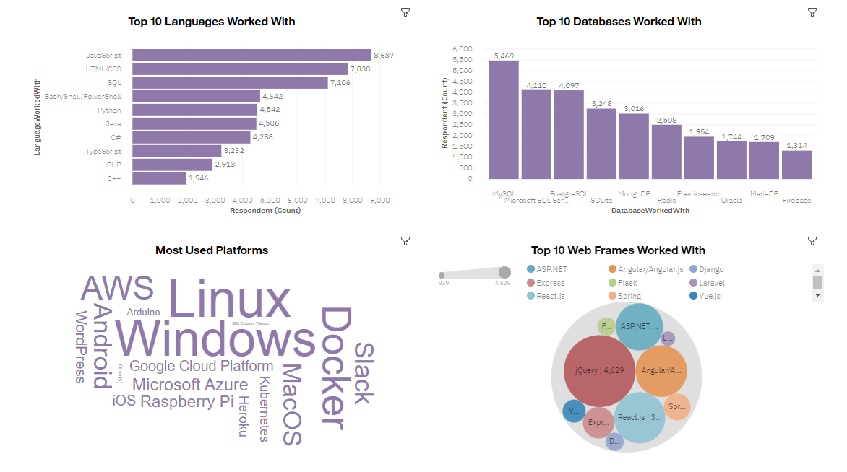
Dashboards(1): CURRENT TECHNOLOGY USAGE

Slide 13
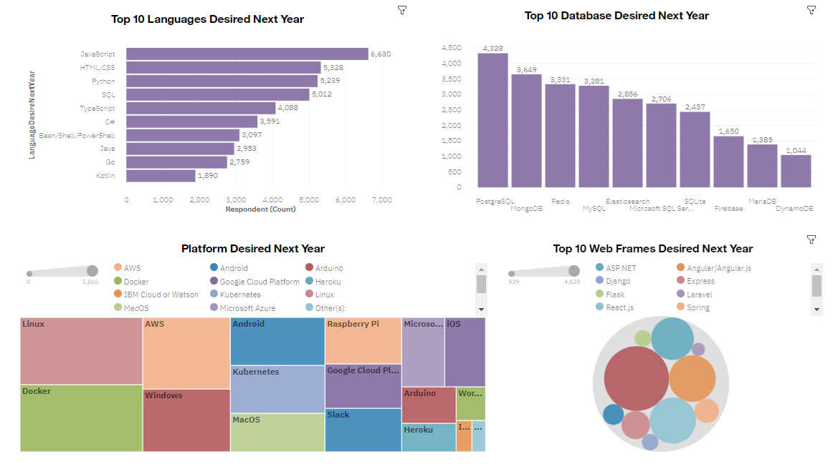
Dashboards(2): FUTURE TECHNOLOGY USAGE

Slide 14
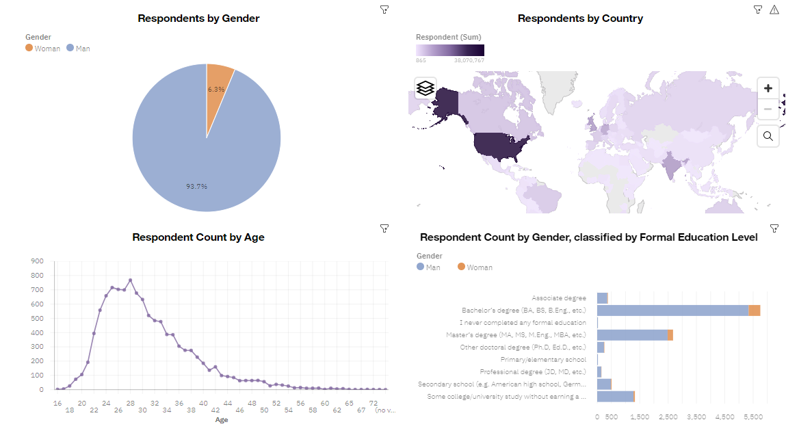
Dashboards(3): DEMOGRAPHICS

Slide 15
DISCUSSION
A part of the 2019 Overflow Developer Survey was collected and examined. The discoveries brought several insights about the technologies most used and desired by developers. Also, some data was analyzed pertaining to the developers’ demographics.
The analysis of these data allows us to better understand the technology market and outline a plan to make the market more agile, effective and diversified.

Slide 16
OVERALL FINDINGS & IMPLICATIONS
Findings
USA is the top technology country
There is a large gender disparity in the technology market
Increasing interest in Python
Javascript and HTML/CSS are widely used languages ​​among developers, but there is a growing interest in Typescript
Implications
More countries should have the opportunity to be exposed to technology and develop in this area
There needs to be more inclusion and incentive programs for women in the technology area as a way of closing this huge gap that exists in the market between genders
SQL prevails in the data space, but there is a demand for professionals in the field to get better at using NoSQL and Python

Slide 17

CONCLUSION
With the data collected, we can better understand current technology and market trends, which is valuable information both to employers and to job seekers
The IT market is in ample development, demanding specialized workers and offering good salaries
However, we can observe some problems such as the concentration of technology in a single country (USA) and a large gender gap where more than 90% of the market is made up of men
Despite these large gaps, as technology becomes more accessible and more integrated with schools’ curricula, we hope to see a more diverse userbase in the future

Slide 18
APPENDIX

Slide 19
JOB POSTINGS

Slide 20
POPULAR LANGUAGES

